Slide 1
CS 7643: Deep Learning
Topics:
Toeplitz matrices and convolutions = matrix-mult
Dilated/a-trous convolutions
Backprop in conv layers
Transposed convolutions
Dhruv Batra
Georgia Tech

Slide 2
Administrativia
HW1 extension
09/22 09/25
HW2 + PS2 both coming out on 09/22 09/25
Note on class schedule coming up
Switching to paper reading starting next week.
https://docs.google.com/spreadsheets/d/1uN31YcWAG6nhjvYPUVKMy3vHwW-h9MZCe8yKCqw0RsU/edit#gid=0
First review due: Mon 09/25
First student presentation due: Thr 09/28

Slide 3
Recap of last time

Slide 4
Convolutional Neural Networks
(without the brain stuff)
Slide Credit: Fei-Fei Li, Justin Johnson, Serena Yeung, CS 231n

Slide 5
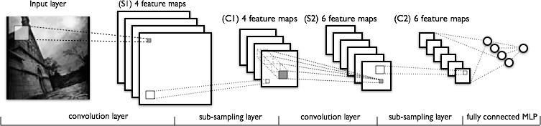
Convolutional Neural Networks
a
Image Credit: Yann LeCun, Kevin Murphy

Slide 6
FC vs Conv Layer

Slide 7

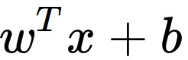
Convolution Layer
32x32x3 image
5x5x3 filter
32
1 number:
the result of taking a dot product between the filter and a small 5x5x3 chunk of the image
(i.e. 5*5*3 = 75-dimensional dot product + bias)
32
3
Slide Credit: Fei-Fei Li, Justin Johnson, Serena Yeung, CS 231n

Slide 8
Convolution Layer
activation map
32x32x3 image
5x5x3 filter
32
28
convolve (slide) over all spatial locations
32
28
3
1
Slide Credit: Fei-Fei Li, Justin Johnson, Serena Yeung, CS 231n

Slide 9
For example, if we had 6 5x5 filters, we’ll get 6 separate activation maps:
activation maps
32
28
Convolution Layer
32
28
3
6
We stack these up to get a “new image” of size 28x28x6!
Slide Credit: Fei-Fei Li, Justin Johnson, Serena Yeung, CS 231n

Slide 10
Preview: ConvNet is a sequence of Convolutional Layers, interspersed with activation functions
32
28
24
….
CONV,
ReLU
e.g. 6 5x5x3 filters
CONV,
ReLU
e.g. 10 5x5x6 filters
CONV,
ReLU
32
28
24
3
6
10
Slide Credit: Fei-Fei Li, Justin Johnson, Serena Yeung, CS 231n

Slide 11
N
Output size:
(N - F) / stride + 1
e.g. N = 7, F = 3:
stride 1 => (7 - 3)/1 + 1 = 5
stride 2 => (7 - 3)/2 + 1 = 3
stride 3 => (7 - 3)/3 + 1 = 2.33 :\
F
F
N
Slide Credit: Fei-Fei Li, Justin Johnson, Serena Yeung, CS 231n

Slide 12
In practice: Common to zero pad the border
0 | 0 | 0 | 0 | 0 | 0
0
0
0
0
e.g. input 7x7
3x3 filter, applied with stride 1
pad with 1 pixel border => what is the output?
7x7 output!
in general, common to see CONV layers with stride 1, filters of size FxF, and zero-padding with (F-1)/2. (will preserve size spatially)
e.g. F = 3 => zero pad with 1
F = 5 => zero pad with 2
F = 7 => zero pad with 3
Slide Credit: Fei-Fei Li, Justin Johnson, Serena Yeung, CS 231n

Slide 13
(btw, 1x1 convolution layers make perfect sense)
1x1 CONV
with 32 filters
56
56
(each filter has size 1x1x64, and performs a 64-dimensional dot product)
56
56
64
32
Slide Credit: Fei-Fei Li, Justin Johnson, Serena Yeung, CS 231n

Slide 14
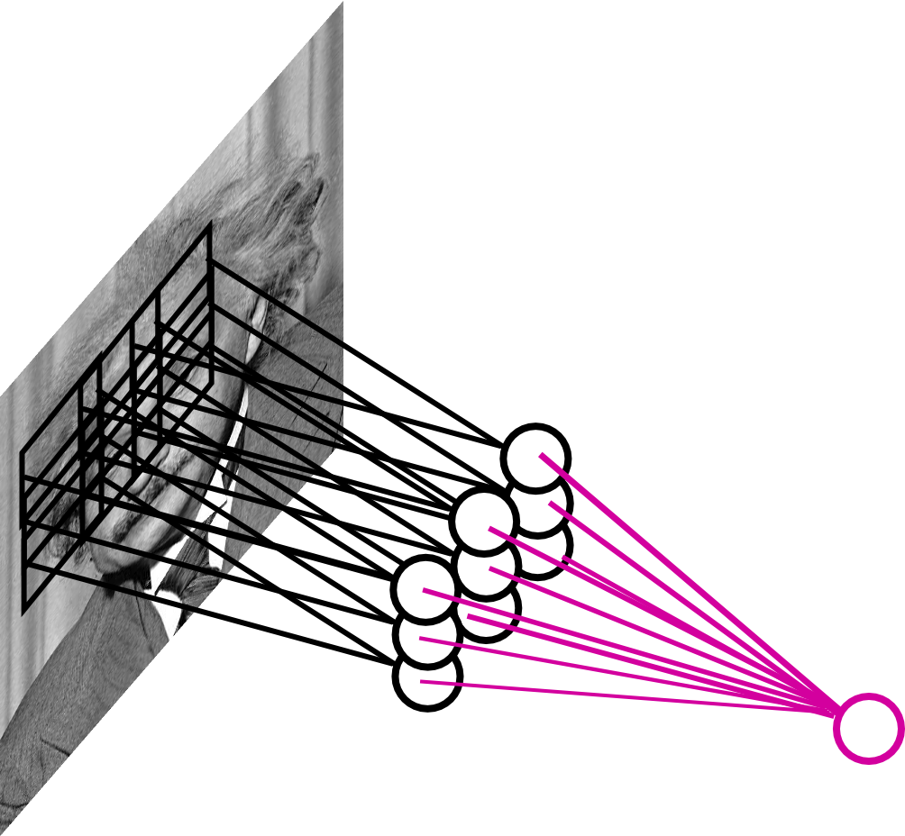
Pooling Layer
By “pooling” (e.g., taking max) filter
responses at different locations we gain robustness to the exact spatial location of features.
Slide Credit: Marc'Aurelio Ranzato

Slide 15
MAX POOLING
Single depth slice
1 | 1 | 2 | 4
5 | 6 | 7 | 8
3 | 2 | 1 | 0
1 | 2 | 3 | 4
dim 1
max pool with 2x2 filters and stride 2
6 | 8
3 | 4
dim 2
Slide Credit: Fei-Fei Li, Justin Johnson, Serena Yeung, CS 231n

Slide 16
Pooling Layer: Examples
Max-pooling:
Average-pooling:
L2-pooling:
L2-pooling over features:
Slide Credit: Marc'Aurelio Ranzato

Slide 17
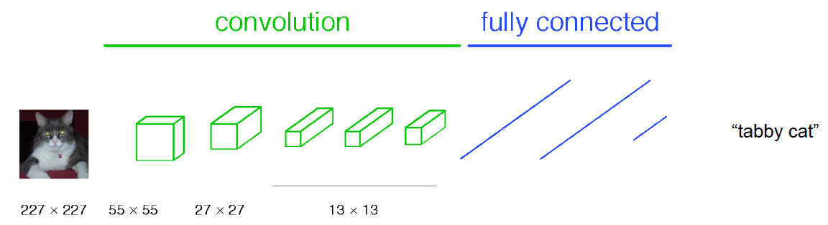
Classical View
Figure Credit: [Long, Shelhamer, Darrell CVPR15]

Slide 18
H hidden units
MxMxN, M small
Fully conn. layer
Slide Credit: Marc'Aurelio Ranzato

Slide 19
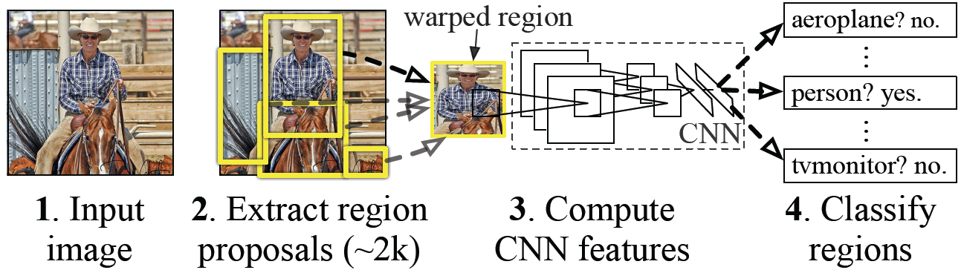
Classical View = Inefficient

Slide 20
Classical View
Figure Credit: [Long, Shelhamer, Darrell CVPR15]

Slide 21
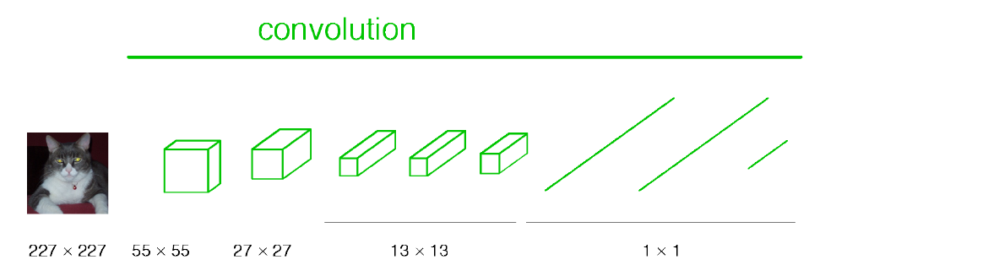
Re-interpretation
Just squint a little!
Figure Credit: [Long, Shelhamer, Darrell CVPR15]

Slide 22
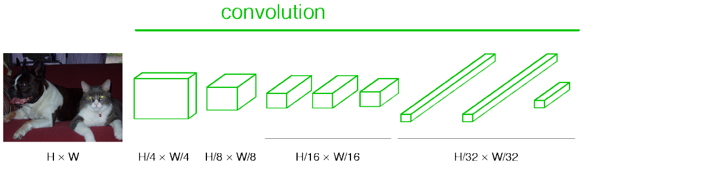
“Fully Convolutional” Networks
Can run on an image of any size!
Figure Credit: [Long, Shelhamer, Darrell CVPR15]

Slide 23
H hidden units /
1x1xH feature maps
MxMxN, M small
Fully conn. layer /
Conv. layer (H kernels of size MxMxN)
Slide Credit: Marc'Aurelio Ranzato

Slide 24
K hidden units /
1x1xK feature maps
H hidden units /
1x1xH feature maps
MxMxN, M small
Fully conn. layer /
Conv. layer (H kernels of size MxMxN)
Fully conn. layer /
Conv. layer (K kernels of size 1x1xH)
Slide Credit: Marc'Aurelio Ranzato

Slide 25
Viewing fully connected layers as convolutional layers enables efficient use of convnets on bigger images (no need to slide windows but unroll network over space as needed to re-use computation).
TRAINING TIME
Input
Image
CNN
TEST TIME
Input
Image
Input
Image
CNN
y
x
Slide Credit: Marc'Aurelio Ranzato

Slide 26
Viewing fully connected layers as convolutional layers enables efficient use of convnets on bigger images (no need to slide windows but unroll network over space as needed to re-use computation).
TRAINING TIME
Input
Image
CNN
TEST TIME
CNNs work on any image size!
Input
Image
CNN
y
x
Unrolling is order of magnitudes more eficient than sliding windows!
Slide Credit: Marc'Aurelio Ranzato

Slide 27
Benefit of this thinking
Mathematically elegant
Efficiency
Can run network on arbitrary image
Without multiple crops

Slide 28
Summary
- ConvNets stack CONV,POOL,FC layers
- Trend towards smaller filters and deeper architectures
- Trend towards getting rid of POOL/FC layers (just CONV)
- Typical architectures look like
[(CONV-RELU)*N-POOL?]*M-(FC-RELU)*K,SOFTMAX
where N is usually up to ~5, M is large, 0 <= K <= 2.
but recent advances such as ResNet/GoogLeNet challenge this paradigm
Slide Credit: Fei-Fei Li, Justin Johnson, Serena Yeung, CS 231n

Slide 29
Plan for Today
Convolutional Neural Networks
Toeplitz matrices and convolutions = matrix-mult
Dilated/a-trous convolutions
Backprop in conv layers
Transposed convolutions

Slide 30
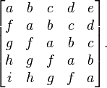
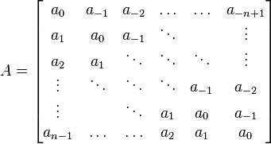
Toeplitz Matrix
Diagonals are constants
A_{ij} = a_{i-j}

Slide 31
Why do we care?
(Discrete) Convolution = Matrix Multiplication
with Toeplitz Matrices

Slide 32


"Convolution of box signal with itself2" by Convolution_of_box_signal_with_itself.gif: Brian Ambergderivative work: Tinos (talk) - Convolution_of_box_signal_with_itself.gif. Licensed under CC BY-SA 3.0 via Commons - https://commons.wikimedia.org/wiki/File:Convolution_of_box_signal_with_itself2.gif#/media/File:Convolution_of_box_signal_with_itself2.gif

Slide 33

Figure Credit: Dumoulin and Visin, https://arxiv.org/pdf/1603.07285.pdf

Slide 34
Plan for Today
Convolutional Neural Networks
Toeplitz matrices and convolutions = matrix-mult
Dilated/a-trous convolutions
Backprop in conv layers
Transposed convolutions

Slide 35
Dilated Convolutions

Slide 36

Dilated Convolutions
Figure Credit: Dumoulin and Visin, https://arxiv.org/pdf/1603.07285.pdf

Slide 37
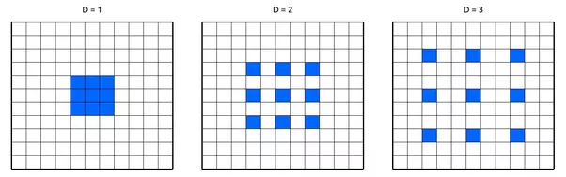

Slide 38
(recall:)
(N - k) / stride + 1
Figure Credit: Dumoulin and Visin, https://arxiv.org/pdf/1603.07285.pdf

Slide 39
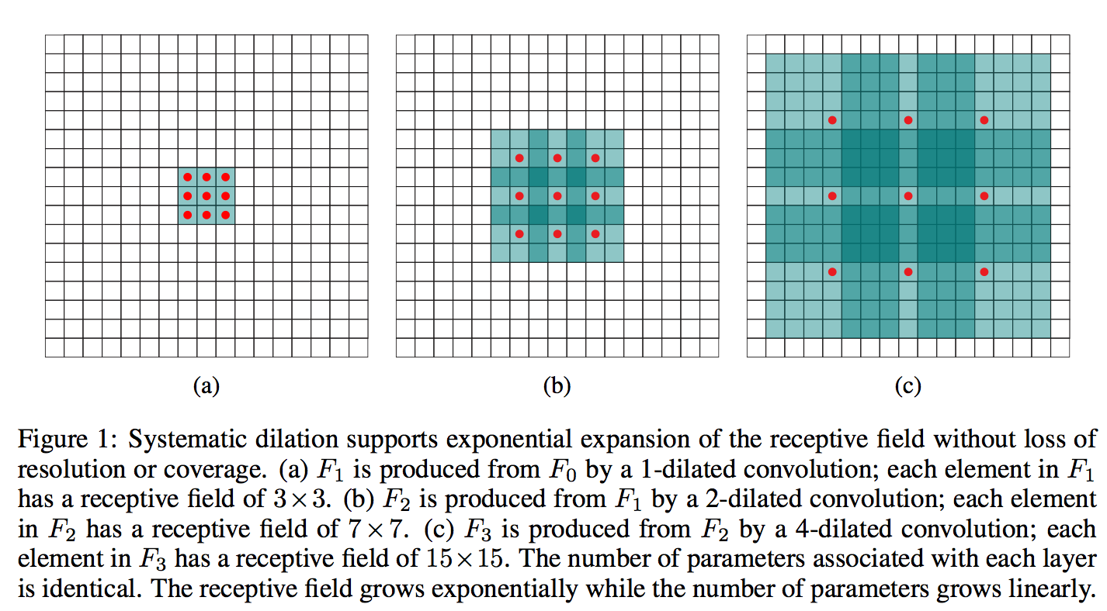
Figure Credit: Yu and Koltun, ICLR16

Slide 40
Plan for Today
Convolutional Neural Networks
Toeplitz matrices and convolutions = matrix-mult
Dilated/a-trous convolutions
Backprop in conv layers
Transposed convolutions

Slide 41
Backprop in Convolutional Layers

Slide 42
Backprop in Convolutional Layers

Slide 43
Backprop in Convolutional Layers

Slide 44
Backprop in Convolutional Layers

Slide 45
Backprop in Convolutional Layers

Slide 46
Backprop in Convolutional Layers

Slide 47
Plan for Today
Convolutional Neural Networks
Toeplitz matrices and convolutions = matrix-mult
Dilated/a-trous convolutions
Backprop in conv layers
Transposed convolutions

Slide 48
Transposed Convolutions
Deconvolution (bad)
Upconvolution
Fractionally strided convolution
Backward strided convolution

Slide 49
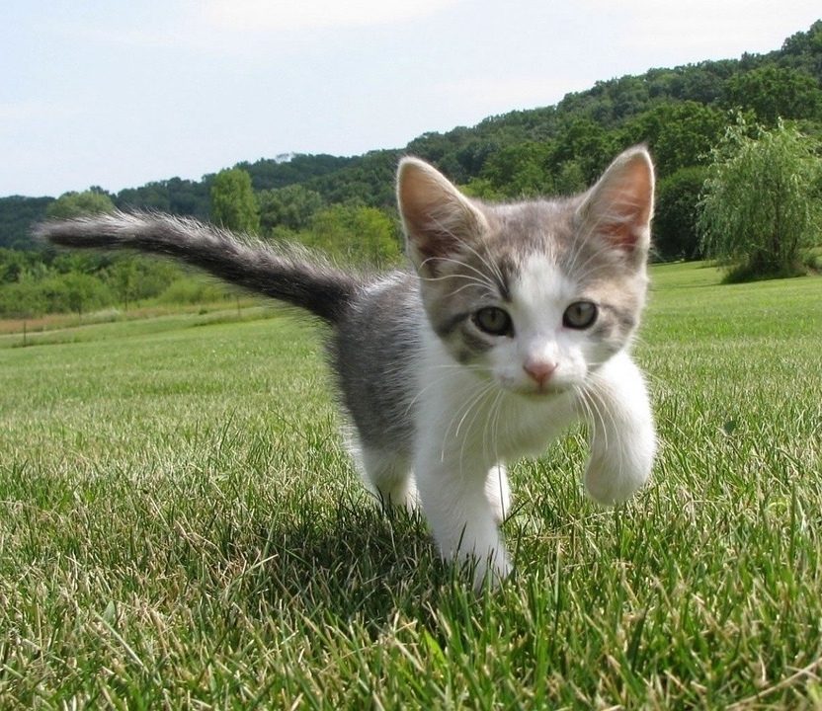
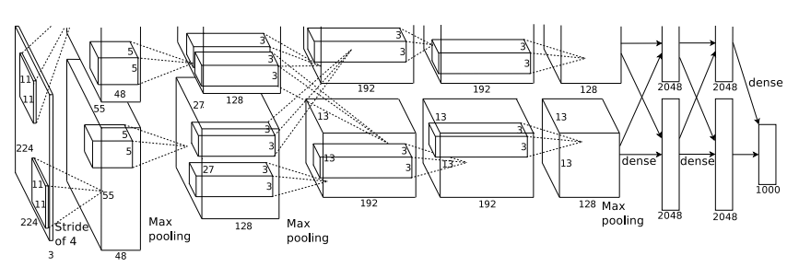
So far: Image Classification
Class Scores
Cat: 0.9
Dog: 0.05
Car: 0.01
...
Fully-Connected:
4096 to 1000
This image is CC0 public domain
Figure copyright Alex Krizhevsky, Ilya Sutskever, and Geoffrey Hinton, 2012. Reproduced with permission.
Vector:
4096
Slide Credit: Fei-Fei Li, Justin Johnson, Serena Yeung, CS 231n

Slide 50
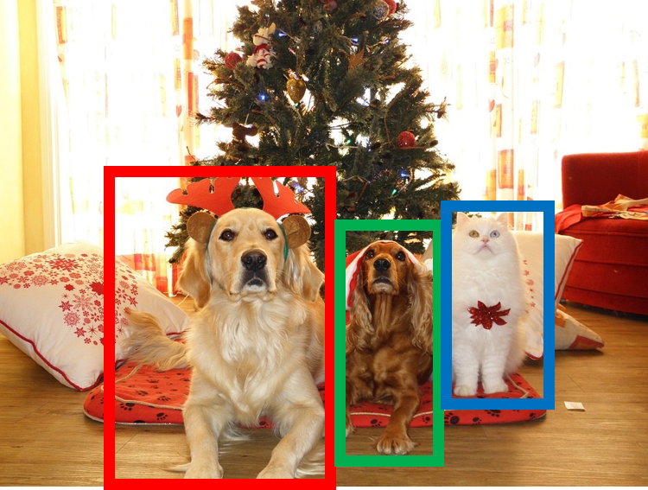
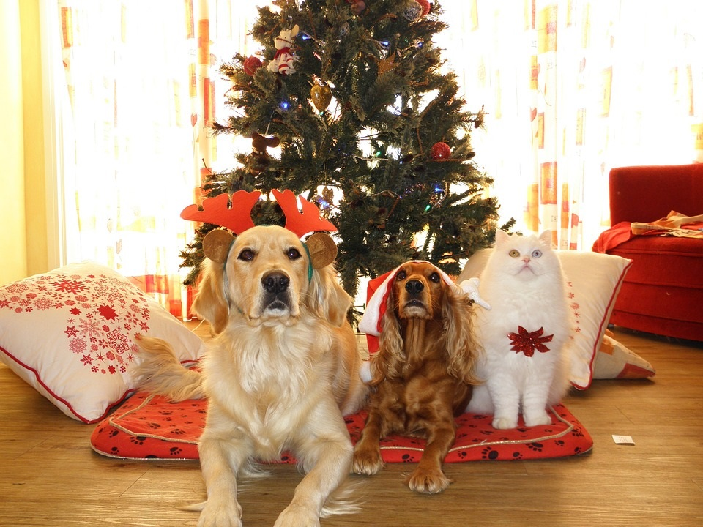
Other Computer Vision Tasks
Semantic Segmentation
Classification + Localization
Object Detection
Instance Segmentation
GRASS, CAT, TREE, SKY
CAT
DOG, DOG, CAT
DOG, DOG, CAT
No objects, just pixels
Single Object
Multiple Object
This image is CC0 public domain
Slide Credit: Fei-Fei Li, Justin Johnson, Serena Yeung, CS 231n

Slide 51
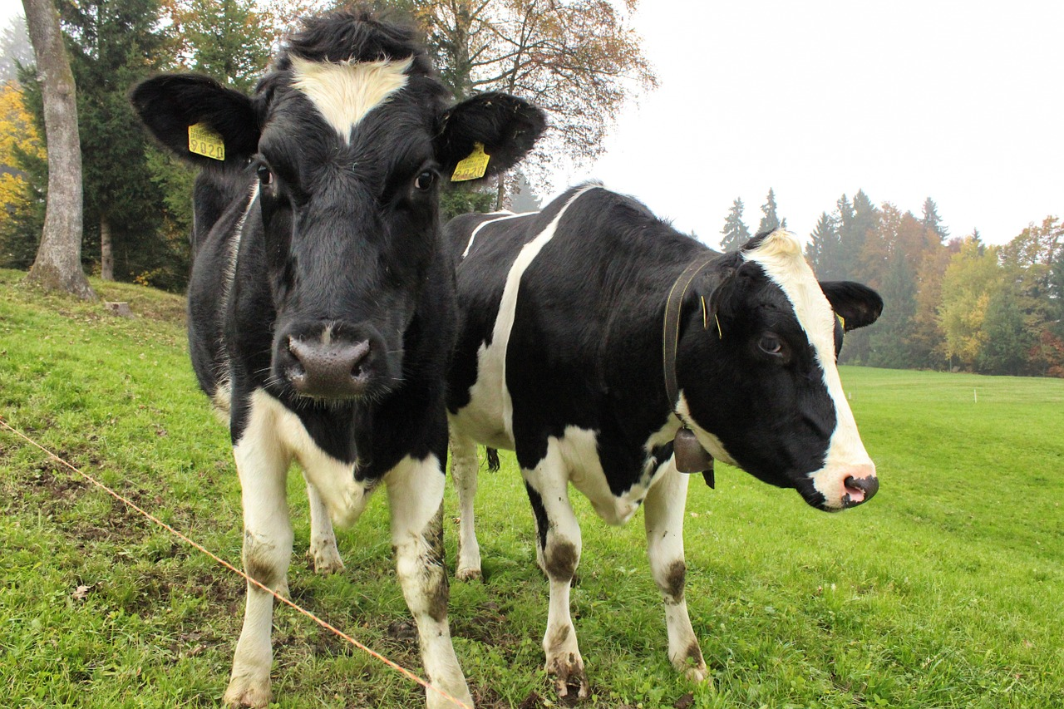
Semantic Segmentation
This image is CC0 public domain
Label each pixel in the image with a category label
Don’t differentiate instances, only care about pixels
Sky
Trees
Sky
Trees
Cat
Cow
Grass
Grass
Slide Credit: Fei-Fei Li, Justin Johnson, Serena Yeung, CS 231n

Slide 52
Semantic Segmentation Idea: Sliding Window
Extract patch
Classify center pixel with CNN
Full image
Cow
Cow
Grass
Farabet et al, “Learning Hierarchical Features for Scene Labeling,” TPAMI 2013
Pinheiro and Collobert, “Recurrent Convolutional Neural Networks for Scene Labeling”, ICML 2014
Slide Credit: Fei-Fei Li, Justin Johnson, Serena Yeung, CS 231n

Slide 53
Semantic Segmentation Idea: Sliding Window
Extract patch
Classify center pixel with CNN
Full image
Cow
Cow
Grass
Problem: Very inefficient! Not reusing shared features between overlapping patches
Farabet et al, “Learning Hierarchical Features for Scene Labeling,” TPAMI 2013
Pinheiro and Collobert, “Recurrent Convolutional Neural Networks for Scene Labeling”, ICML 2014
Slide Credit: Fei-Fei Li, Justin Johnson, Serena Yeung, CS 231n

Slide 54
Semantic Segmentation Idea: Fully Convolutional
Design a network as a bunch of convolutional layers to make predictions for pixels all at once!
Conv
Conv
Conv
Conv
argmax
Input:
3 x H x W
Predictions:
H x W
Scores:
C x H x W
Convolutions:
D x H x W
Slide Credit: Fei-Fei Li, Justin Johnson, Serena Yeung, CS 231n

Slide 55
Semantic Segmentation Idea: Fully Convolutional
Design a network as a bunch of convolutional layers to make predictions for pixels all at once!
Conv
Conv
Conv
Conv
argmax
Input:
3 x H x W
Predictions:
H x W
Scores:
C x H x W
Problem: convolutions at original image resolution will be very expensive ...
Convolutions:
D x H x W
Slide Credit: Fei-Fei Li, Justin Johnson, Serena Yeung, CS 231n

Slide 56
Semantic Segmentation Idea: Fully Convolutional
Design network as a bunch of convolutional layers, with downsampling and upsampling inside the network!
Med-res:
D₂ x H/4 x W/4
Med-res:
D₂ x H/4 x W/4
Low-res:
D₃ x H/4 x W/4
Input:
3 x H x W
High-res:
D₁ x H/2 x W/2
High-res:
D₁ x H/2 x W/2
Predictions:
H x W
Long, Shelhamer, and Darrell, “Fully Convolutional Networks for Semantic Segmentation”, CVPR 2015 Noh et al, “Learning Deconvolution Network for Semantic Segmentation”, ICCV 2015
Slide Credit: Fei-Fei Li, Justin Johnson, Serena Yeung, CS 231n

Slide 57
Semantic Segmentation Idea: Fully Convolutional
Downsampling:
Pooling, strided convolution
Design network as a bunch of convolutional layers, with downsampling and upsampling inside the network!
Upsampling:
???
Med-res:
D₂ x H/4 x W/4
Med-res:
D₂ x H/4 x W/4
Low-res:
D₃ x H/4 x W/4
Input:
3 x H x W
High-res:
D₁ x H/2 x W/2
High-res:
D₁ x H/2 x W/2
Predictions:
H x W
Long, Shelhamer, and Darrell, “Fully Convolutional Networks for Semantic Segmentation”, CVPR 2015 Noh et al, “Learning Deconvolution Network for Semantic Segmentation”, ICCV 2015
Slide Credit: Fei-Fei Li, Justin Johnson, Serena Yeung, CS 231n

Slide 58
In-Network upsampling: “Unpooling”
Nearest Neighbor
“Bed of Nails”
1 | 0 | 2 | 0
0 | 0 | 0 | 0
3 | 0 | 4 | 0
0 | 0 | 0 | 0
1 | 1 | 2 | 2
1 | 1 | 2 | 2
3 | 3 | 4 | 4
3 | 3 | 4 | 4
1 | 2
3 | 4
1 | 2
3 | 4
Input: 2 x 2
Output: 4 x 4
Input: 2 x 2
Output: 4 x 4
Slide Credit: Fei-Fei Li, Justin Johnson, Serena Yeung, CS 231n

Slide 59
In-Network upsampling: “Max Unpooling”
Max Pooling
Remember which element was max!
Max Unpooling
Use positions from pooling layer
1 | 2 | 6 | 3
3 | 5 | 2 | 1
1 | 2 | 2 | 1
7 | 3 | 4 | 8
0 | 0 | 2 | 0
0 | 1 | 0 | 0
0 | 0 | 0 | 0
3 | 0 | 0 | 4
5 | 6
7 | 8
…
1 | 2
3 | 4
Rest of the network
Input: 4 x 4
Output: 2 x 2
Input: 2 x 2
Output: 4 x 4
Corresponding pairs of downsampling and upsampling layers
Slide Credit: Fei-Fei Li, Justin Johnson, Serena Yeung, CS 231n

Slide 60
Learnable Upsampling: Transpose Convolution
Recall:Typical 3 x 3 convolution, stride 1 pad 1
Input: 4 x 4
Output: 4 x 4
Slide Credit: Fei-Fei Li, Justin Johnson, Serena Yeung, CS 231n

Slide 61
Learnable Upsampling: Transpose Convolution
Recall: Normal 3 x 3 convolution, stride 1 pad 1
Dot product between filter and input
Input: 4 x 4
Output: 4 x 4
Slide Credit: Fei-Fei Li, Justin Johnson, Serena Yeung, CS 231n

Slide 62
Learnable Upsampling: Transpose Convolution
Recall: Normal 3 x 3 convolution, stride 1 pad 1
Dot product between filter and input
Input: 4 x 4
Output: 4 x 4
Slide Credit: Fei-Fei Li, Justin Johnson, Serena Yeung, CS 231n

Slide 63
Learnable Upsampling: Transpose Convolution
Recall: Normal 3 x 3 convolution, stride 2 pad 1
Input: 4 x 4
Output: 2 x 2
Slide Credit: Fei-Fei Li, Justin Johnson, Serena Yeung, CS 231n

Slide 64
Learnable Upsampling: Transpose Convolution
Recall: Normal 3 x 3 convolution, stride 2 pad 1
Dot product between filter and input
Input: 4 x 4
Output: 2 x 2
Slide Credit: Fei-Fei Li, Justin Johnson, Serena Yeung, CS 231n

Slide 65
Learnable Upsampling: Transpose Convolution
Recall: Normal 3 x 3 convolution, stride 2 pad 1
Filter moves 2 pixels in the input for every one pixel in the output
Stride gives ratio between movement in input and output
Dot product between filter and input
Input: 4 x 4
Output: 2 x 2
Slide Credit: Fei-Fei Li, Justin Johnson, Serena Yeung, CS 231n

Slide 66
Learnable Upsampling: Transpose Convolution
3 x 3 transpose convolution, stride 2 pad 1
Input: 2 x 2
Output: 4 x 4
Slide Credit: Fei-Fei Li, Justin Johnson, Serena Yeung, CS 231n

Slide 67
Learnable Upsampling: Transpose Convolution
3 x 3 transpose convolution, stride 2 pad 1
Input gives weight for filter
Input: 2 x 2
Output: 4 x 4
Slide Credit: Fei-Fei Li, Justin Johnson, Serena Yeung, CS 231n

Slide 68
Learnable Upsampling: Transpose Convolution
3 x 3 transpose convolution, stride 2 pad 1
Sum where output overlaps
Filter moves 2 pixels in the output for every one pixel in the input
Stride gives ratio between movement in output and input
Input gives weight for filter
Input: 2 x 2
Output: 4 x 4
Slide Credit: Fei-Fei Li, Justin Johnson, Serena Yeung, CS 231n

Slide 69
Learnable Upsampling: Transpose Convolution
3 x 3 transpose convolution, stride 2 pad 1
Sum where output overlaps
Other names:
-Deconvolution (bad)
-Upconvolution
-Fractionally strided convolution
-Backward strided convolution
Filter moves 2 pixels in the output for every one pixel in the input
Stride gives ratio between movement in output and input
Input gives weight for filter
Input: 2 x 2
Output: 4 x 4
Slide Credit: Fei-Fei Li, Justin Johnson, Serena Yeung, CS 231n

Slide 70
Transpose Convolution: 1D Example
Output
Input
Filter
ax
ay
az + bx
by
bz
Output contains copies of the filter weighted by the input, summing at where at overlaps in the output
Need to crop one pixel from output to make output exactly 2x input
x
y
z
a
b
Slide Credit: Fei-Fei Li, Justin Johnson, Serena Yeung, CS 231n

Slide 71
Transposed Convolution
https://distill.pub/2016/deconv-checkerboard/

